Slide 1
Text Summarization of BBC News Articles
Saketh Dathrika
Lasya Manthripragada
Varsha Anugu
Nithish Podeti

Slide 2
Description
In recent years, automatic text summarization has become a well-studied NLP problem. Machine learning models are built that can extract important information from a bigger piece of text and condense it into a smaller one.
Deep neural networks have shown to be an excellent method for text summarization, and the concept has a wide range of applications.
Text ad creation in internet search advertising is one conceivable use. Extractive summarization process involves giving scores to sentences using some method and then using the sentences that achieve highest scores as summaries.
This project aims to develop a model which gives text summarization from news articles.

Slide 3
Dataset
Dataset is taken from Kaggle: https://www.kaggle.com/pariza/bbc-news-summary
This dataset is used for extractive text summarization has business, political, sports, entertainment, and tech news articles of BBC from 2004 to 2005 in the News Articles folder.
For each article, five summaries are provided in the Summaries folder. The first clause of the text of articles is the respective title

Slide 4
Data cleaning
We did basic data cleaning like
Removing emails
Removing new lines
Removing quotes
We tokenized the data and lemmatized it.
We also vectorized the data using countVectorizer.

Slide 5
Tools and Models
The tools which we used are Scikit-learn and Tensorflow, as well as matplotlib and seaborn for some visualization.
We used LDA from Gensim package and 3- stacked LSTM to summarize the news article.
Stacked LSTM has multiple layers of LSTM stacked on top of each other. This leads to a better representation of the sequence.
We visualized the data, and test whether the summarization for each news article is accurate or not.

Slide 6
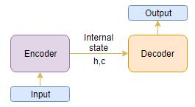
3-STACKED LSTM
The 3-Stacked LSTM uses encoder-decoder architecture.
We can set up the Encoder-Decoder in 2 phases:
Training phase
Inference phase

Slide 7
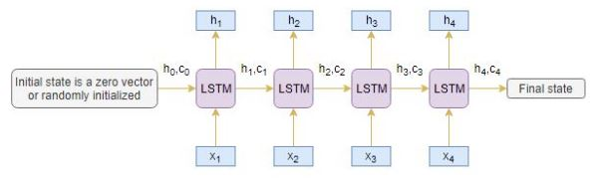
Training phase of Encoder
The complete input sequence is read by an encoder Long Short Term Memory model (LSTM), with one word being sent into the encoder at each timestep.
The information is then processed at each timestep, and the contextual information existing in the input sequence is captured.
The hidden state (h_{i}) and cell state (c_{i}) of the last time step are used to initialize the decoder.

Slide 8
Working Methodology of Decoder
The decoder also analyses the whole target sequence word-by-word and predicts a sequence that is one timestep delayed. Given the previous word, the decoder is trained to anticipate the next word in the sequence.
<start> and <end> are the special tokens which are added to the target sequence before feeding it into the decoder. The target sequence is unknown while decoding the test sequence.
We start predicting the target sequence by passing the first word into the decoder which would be always the <start> token. And the <end> token signals the end of the sentence.

Slide 9
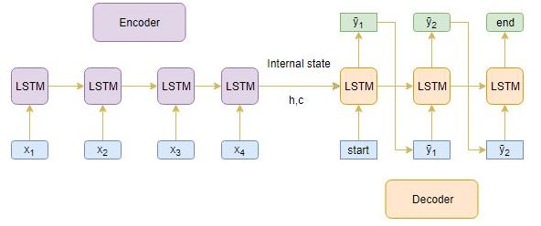
Inference Phase
After training, the model is put to the test on new source sequences with unknown target sequences. To decode a test sequence, we must first build up the inference architecture.

Slide 10
Attention Mechanism
This type of architecture works only for short sentences to overcome this issue we used attention layer to predict a word by looking at a few specific parts of the sequence only, rather than the entire sequence.
Depending on how the attended context vector is formed, there are two types of attention mechanisms.
Global Attention
Local Attention
We used Global attention to train the model.

Slide 11

Metrics
ROUGE (Recall-Oriented Understudy for Gisting Evaluation) is a set of metrics and a software package used for evaluating automatic summarization and machine translation software in natural language processing.
The metrics compare an automatically produced summary or translation against a reference or a set of references (human-produced) summary or translation.
There are many metrics in Rouge, and we used Rouge-1 metric to evaluate the model performance. It refers to the overlap of unigram (each word) between the system and reference summaries.
It can be computed as :

Slide 12
LDA
LDA (short for Latent Dirichlet Allocation) is an unsupervised machine-learning model that takes documents as input and finds topics as output. The model also says in what percentage each document talks about each topic.
There are 3 main parameters of the model:
the number of topics
the number of words per topic
the number of topics per document

Slide 13
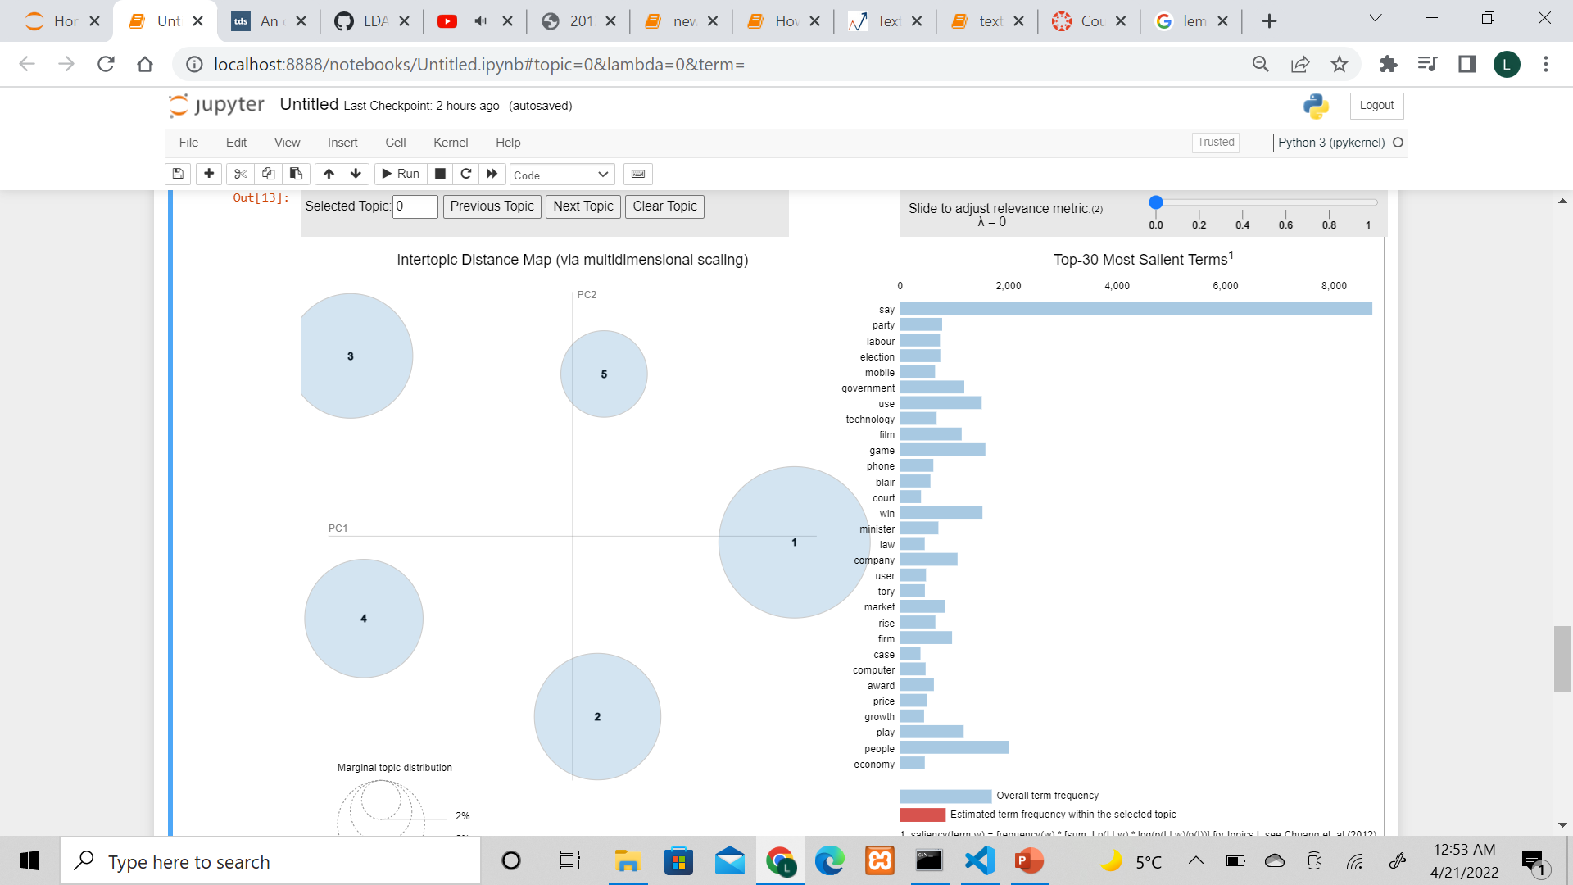
LDA
There is a nice way to visualize the LDA model you built using the package pyLDAvis.
This visualization allows you to compare topics on two reduced dimensions and observe the distribution of words in topics.

Slide 14
LDA
LDA Input:
M no. of documents
Each of these documents have N no. of words
Hyperparameters- alpha and beta
All of which needs to pass through LDA
LDA Output:
K no. of topics (cluster of words)
Document to topic distribution and Topic-term distribution

Slide 15
LDA Advantages and Disadvantages
Advantages:
It is fast
It is intuitive
It can predict topics for new unseen documents.
Dis-Advantages:
It requires Fine tuning.
It needs human interpretation

Slide 16
Metrics
To check if the model is good in LDA we see three metrics:
Topics should be interpretable.
Topics are unique
All the documents should be represented.

Slide 17
Results
Metric of LSTM | Precision | Recall | F-score
Rouge-1 | 0.45 | 0.26 | 0.34
Metrics of LDA | Value
Log-likelihood | -2616563.631168631
Perplexity | 1369.4588046576564

Slide 18
Conclusion
We started LSTM for text summarization but could not get the desired results because as we increase the number of parameters in LSTM the computation cost of the model is increasing which requires additional GPU resources to collaborate it.
In addition to it, we built a basic topic model using Gensim’s LDA and visualize the topics using pyLDAvis.

Slide 19
Future Works
Build a BERT( Bidirectional Encoders) Model to get advanced text summarizations. As the model will be large because of the training structure and corpus. It is slow to train because it is big and there are a lot of weights to update. It requires more computation because of its size, which comes at a cost.
Hence limited the project using 3 Stacked LSTM and LDA models.

Slide 20
THANK YOU

